Slide 1

Azure Service Bus

Slide 2
Azure Service Bus
Fully managed enterprise message broker which allows to send messages asynchronously.
Infrastructure fully managed by Azure.
Introduced in the year 2011.
One of the most important and widely used service in Azure.
Uses AMQP 1.0 as underlying protocol to communicate between sender and receiver services. Also supports legacy SBMP protocol for legacy .NET framework applications.

Slide 3
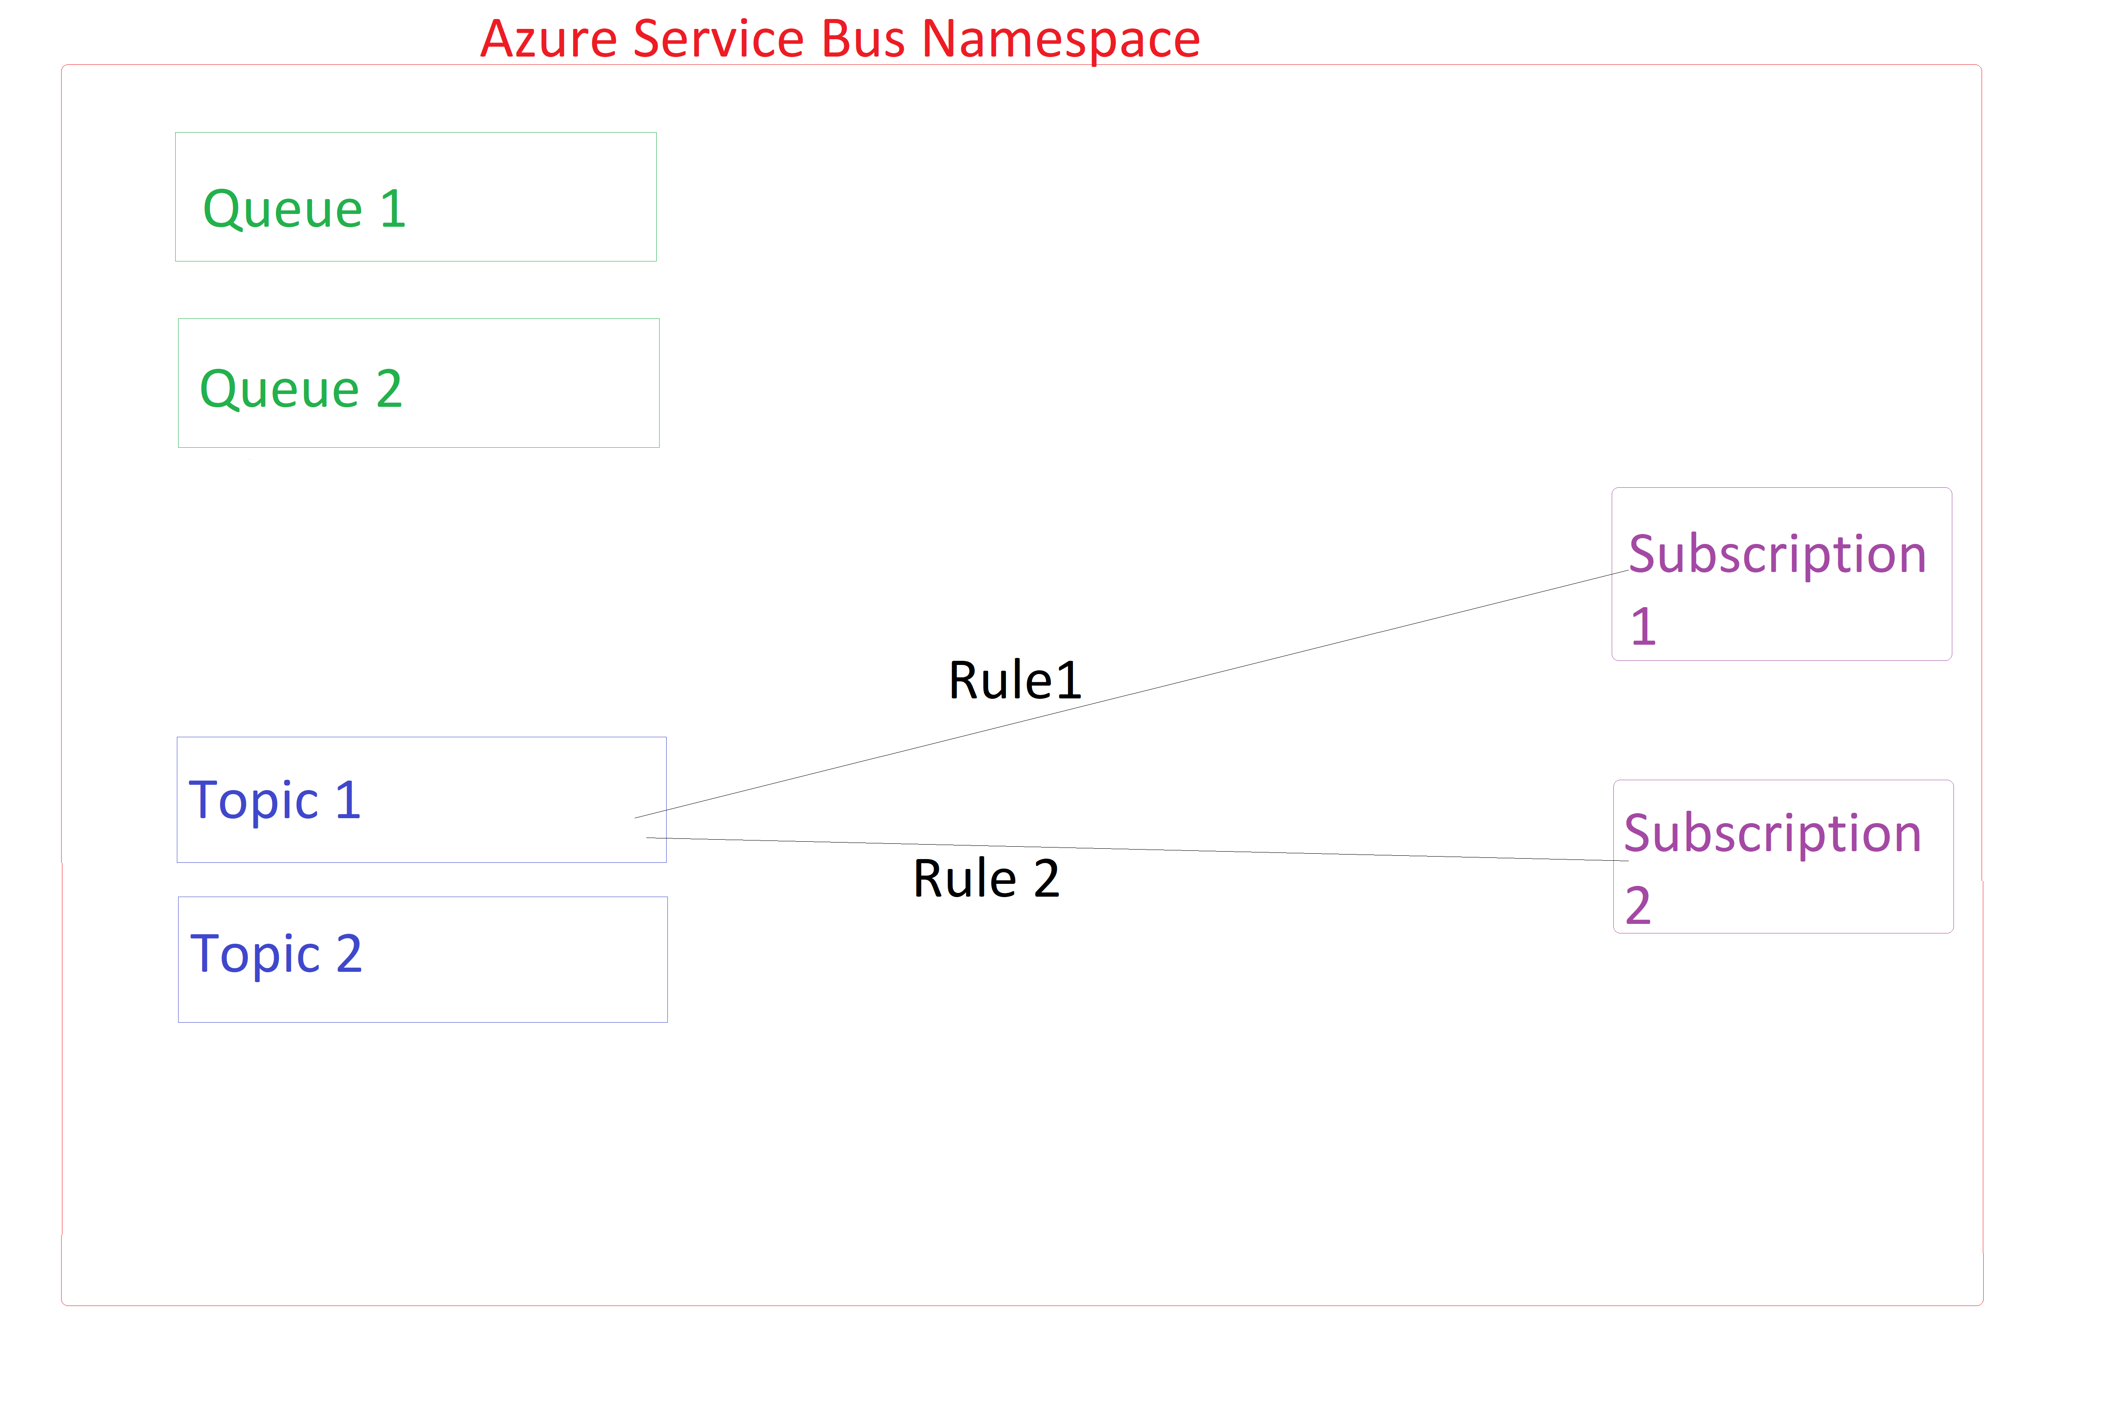
Core concepts
Namespace
Queues
Topic
Subscriptions
Filter Actions (Rules)

Slide 4
Namespace sits on top of the hierarchy.
There are 2 entities in a service bus namespace –
Queues (Suited for 1 sender, 1 receiver style applications)
Topics and Subscriptions (Suited for 1 sender, N receiver style applications, Rules allow to route the incoming message to subscription)
Queues and topics/subscriptions live under a single namespace.
No. of queues + No. of topics should be less than or equal to 10000 in a service bus namespace.
At max we can create 1000 Azure Service Bus Namespaces in our Azure Subscription.

Slide 5
Messages can have TTL up to long.MaxValue seconds.
Messages inside the Azure Service bus queue/subscriptions are encrypted with Azure Storage Service Encryption (Azure SSE).
SDK(s) available in C#, Java, PHP, Node.js, Python and Rest API(s).
Excellent WPF desktop application built by community to manage Azure Service Bus namespace.
To authenticate our application to Azure Service Bus we can use –
Managed Identities
Azure AD
Shared Access policies on the namespace level.
Shared Access policies on the queue/topic level.

Slide 6
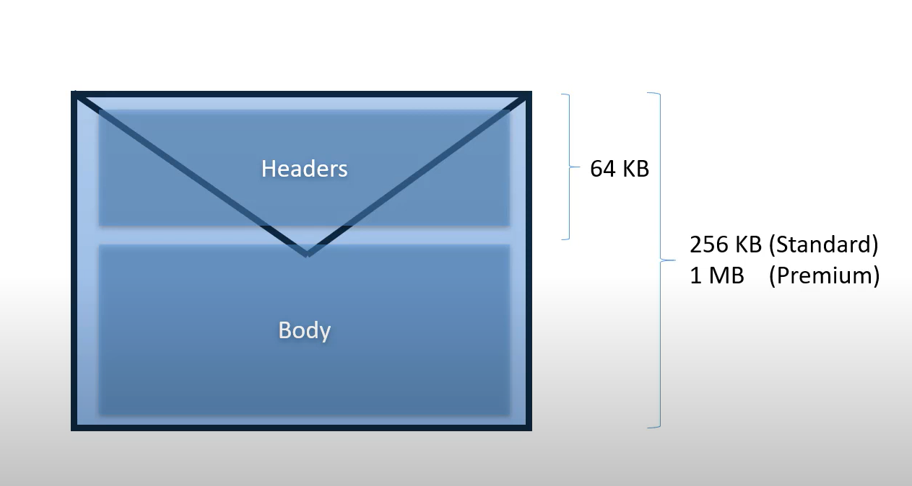
Message Structure
64 KB is reserved for AMQP headers.
The remaining we can utilize for the message payload.
For basic and standard tiers, the remaining data can be of 128 KB size, totaling to 256 KB.
And for premium tier we can have up to 960 KB worth of data, totaling to 1 MB.

Slide 7
Message Receive modes
Messages are delivered by Azure Service Bus to the consumer in one of the two modes –
Peek lock (At least once semantics)
Receive and Delete (At most once semantics)

Slide 8
Peek lock mode
Step 1) Consumer sends receive message request.
Step 2) It locks the current message (until LockedUntil property) which is being read so that other consumers can’t read it.
Step 3) Consumer processes the message.
Step 3a) If the lock expires while reading the message, the delivery count is incremented, and the message is redelivered.
Step 3b) If any application-level exception occurs, the message is auto abandoned.
Step 4) Consumer marks the message to one of the following states –
Consumer
Complete
Dead letter
Abandon
Defer
Message marked as completed and dequeued from the queue.
Message moved to the dead-letter subqueue.
The lock is released, and the message becomes visible on the queue, so that other consumers can consume it.
Message remains on the queue and received later using the SequenceNumber property.

Slide 9
Dead letter queue (DLQ) –
Azure service bus provides an implicitly created secondary sub-queue associated to each queue/topic.
Dead letter queue need not be explicitly created.
Dead letter queue can’t be deleted.
Their purpose is to hold poison/undelivered/unprocessable messages which the operator can take corrective action and re-submit the message if needed.

Slide 10
Receive and Delete mode
Step 1) Consumer sends receive message request.
Step 2) Consumer processes the message.
Step 2a) If the lock expires while reading the message, the delivery count is not incremented, and the message is not redelivered.
Step 2b) If any application-level exception happens, the message is not redelivered.
Step 3) Message is automatically completed.

Slide 11
C# SDK
To communicate with the Azure Service Bus (ASB) we have the following options –
WindowsAzure.ServiceBus (Older and deprecated library which supports SBMP protocol and .NET framework only).
Microsoft.Azure.ServiceBus (Deprecated library from Nov 2020)
Azure.Messaging.ServiceBus (Default and recommended library Nov 2020 onwards)
Microsoft recommends registering ServiceBusClient as Singleton.
Message consumers in C# can be –
Console Application
.NET core background service
Azure Functions

Slide 12
Azure Messaging ServiceBus quick reference
ServiceBusClient – Top level client which holds the underlying AMQP 1.0 connection obtained after doing TCP and TLS handshakes.
ServiceBusSender – Client to publish message(s) to queue/topic.
ServiceBusProcessor – Abstraction over ServiceBusReceiver providing two events ProcessMessageAsync and ProcessErrorAsync.

Slide 13
Pricing
Like many Azure Services, Azure Service Bus also follows the pricing tiers model.
Basic – Only queues supported, no topics and subscription and other advanced features. No monthly charge. Shared infrastructure. First 1 million requests at $ 0.05.
Standard – Base charge of $9.855 a month ($0.0135 per hour * 730 hours in a month) which includes first 13 million requests. Lots of advanced features provided like de-duplication, transaction, auto-forwarding, sessions, etc. Shared infrastructure like Basic.
Premium – Same features as standard along with larger payload size 1 MB and dedicated infrastructure and Geo redundancy. $0.928 charged hourly which is about ($0.928 per hour * 730 hours in a month = $677.44).

Slide 14

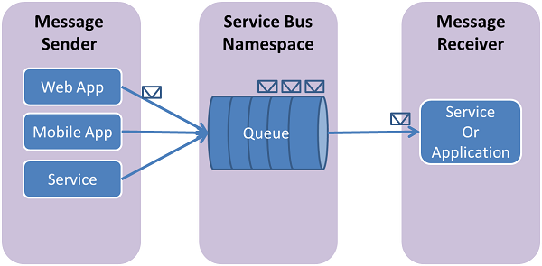
Azure Service Bus Queues
Suited for 1 producer – 1 consumer kind of scenarios.
FIFO ordering of messages is not guaranteed.
Queue acts as intermediary (broker).
Producer publishes the message to the queue and the consumer pulls the message from the queue and processes it.

Slide 15
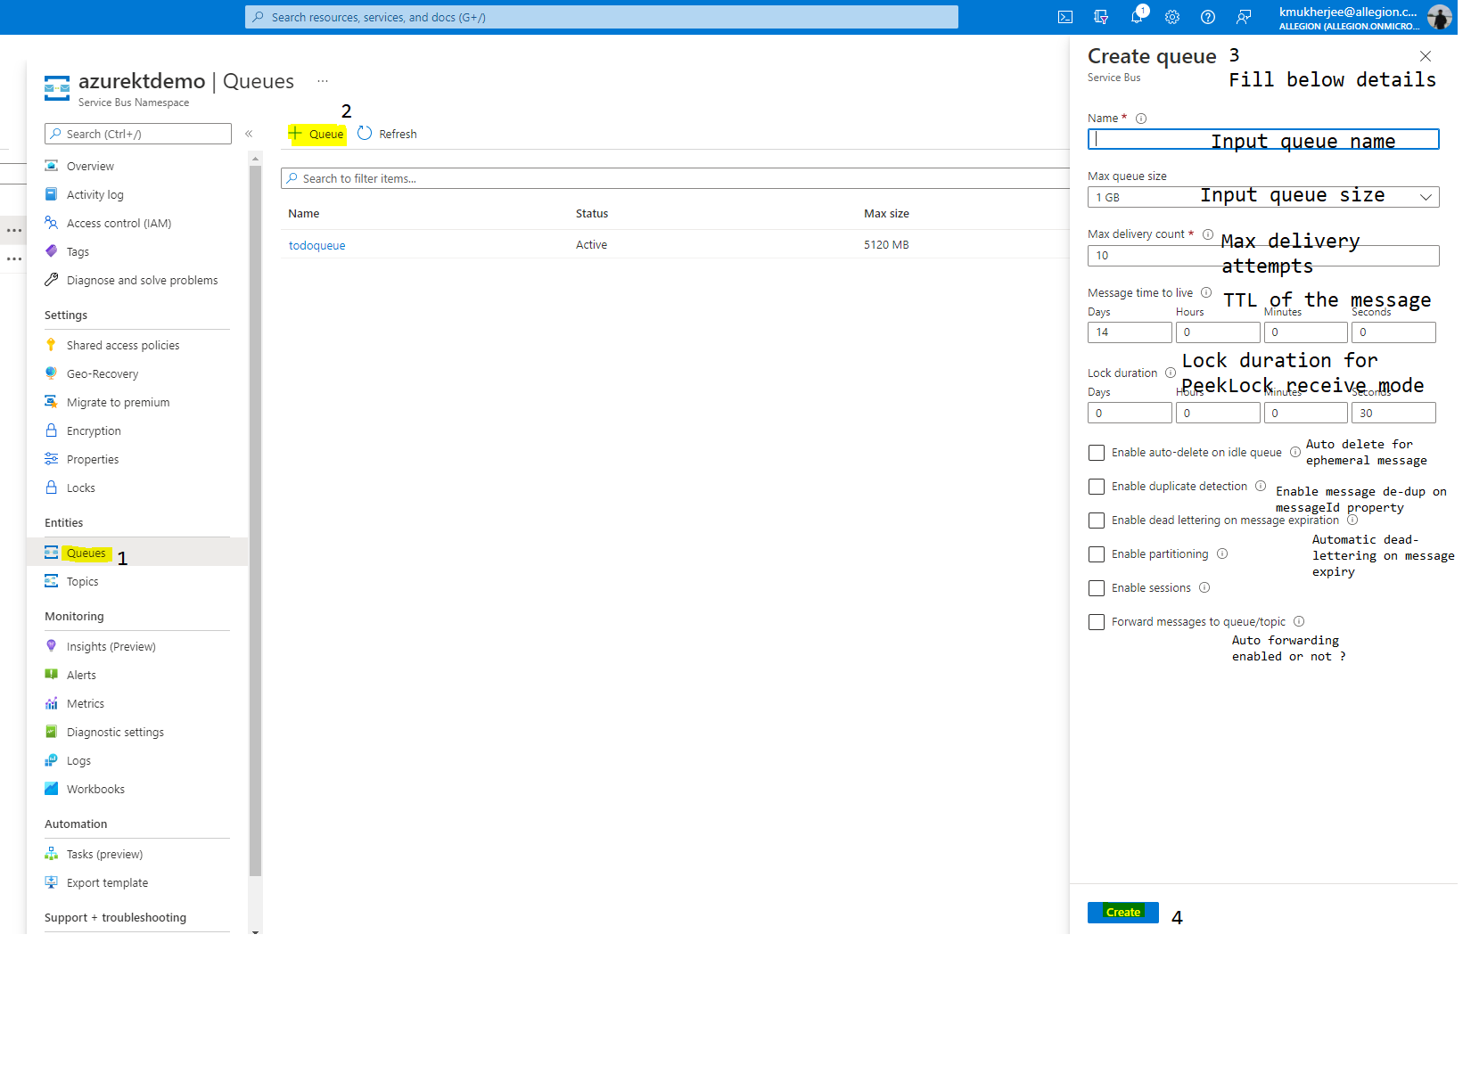
Create queue wizard under Service Bus namespace

Slide 16
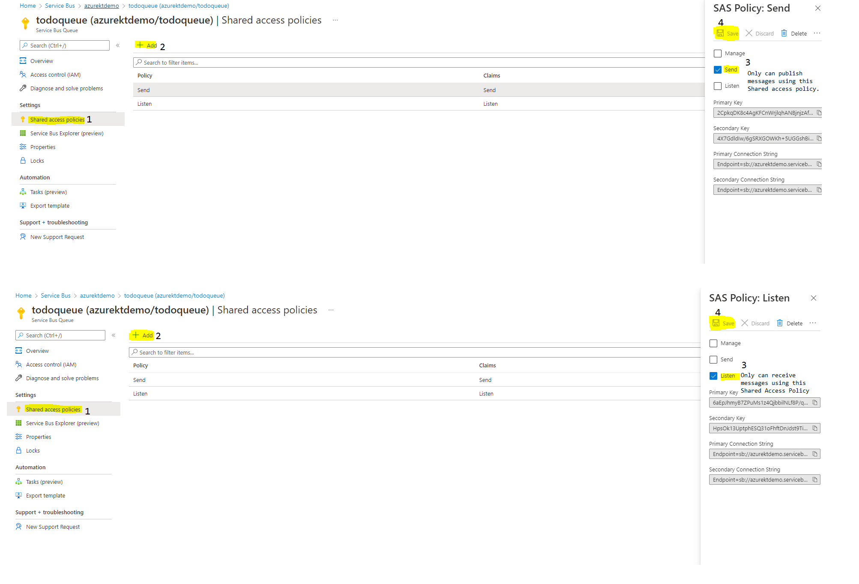
Obtain Shared Access Policies (Send and Listen)

Slide 17
SERVICE BUS QUEUE DEMO

Slide 18
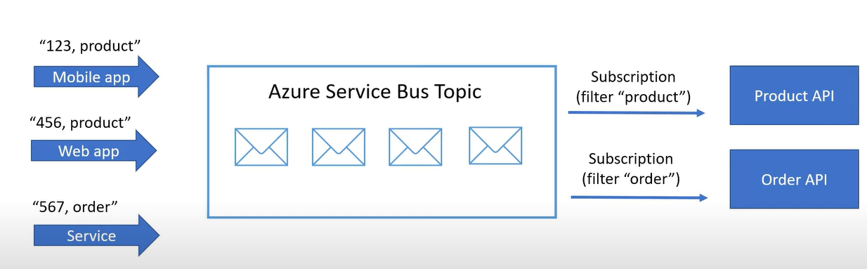

Azure Service Bus Topics
Suited for 1 producer – N consumers kind of scenarios.
Producer publishes the message to topic and is unaware of the downstream subscriptions.
Consumers don’t receive message directly from topic but from subscriptions.
By default, message is forwarded/fan-out to all downstream subscriptions by the topic.
We can route messages to certain desired subscriptions using filter actions (rules) based on the message properties.
We can create up to 2000 subscriptions in a topic.

Slide 19
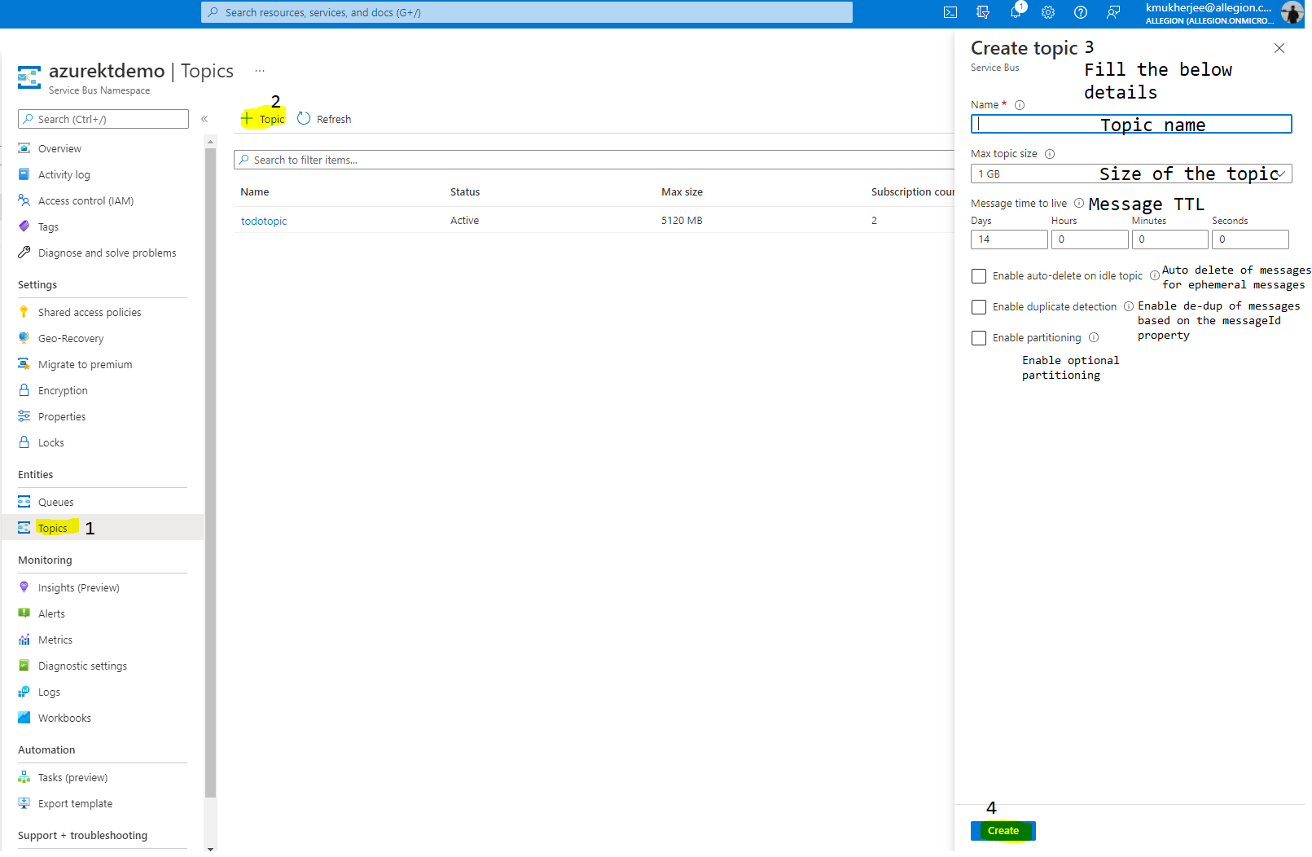
Create topic wizard under Service Bus namespace

Slide 20
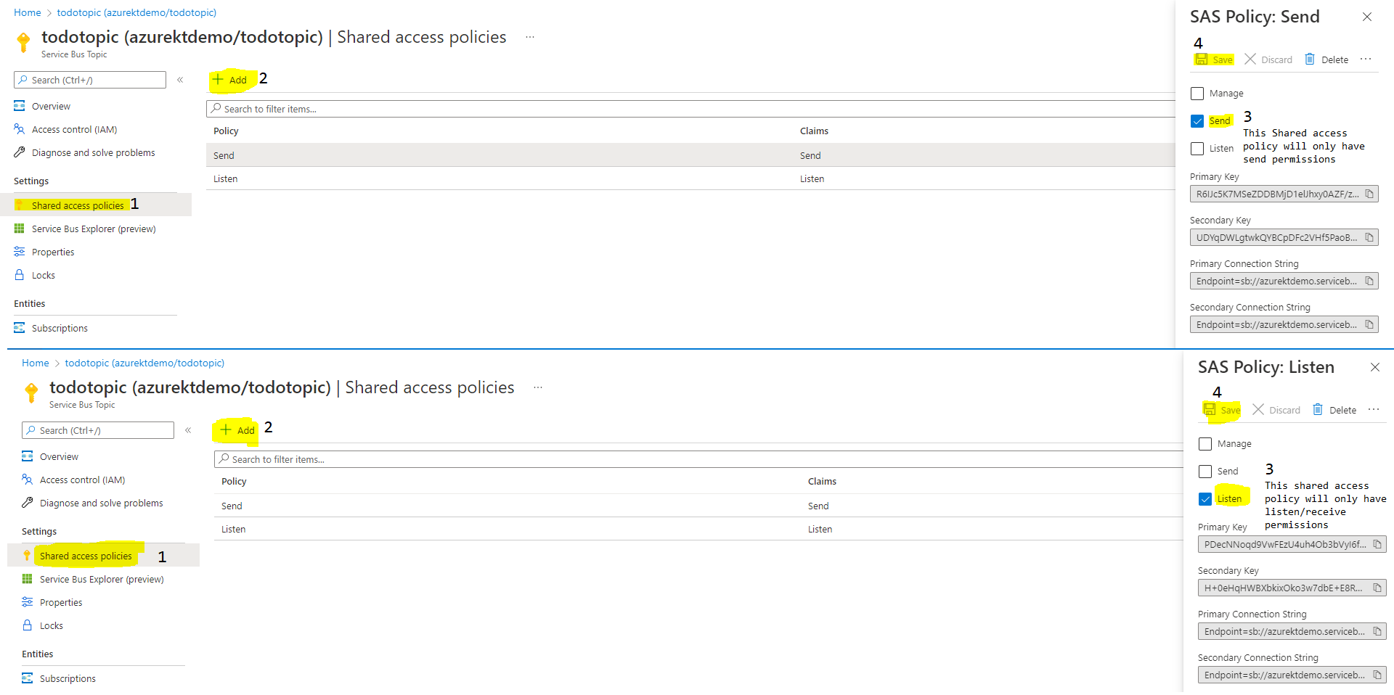
Obtain Shared Access Policies (Send and Listen)

Slide 21
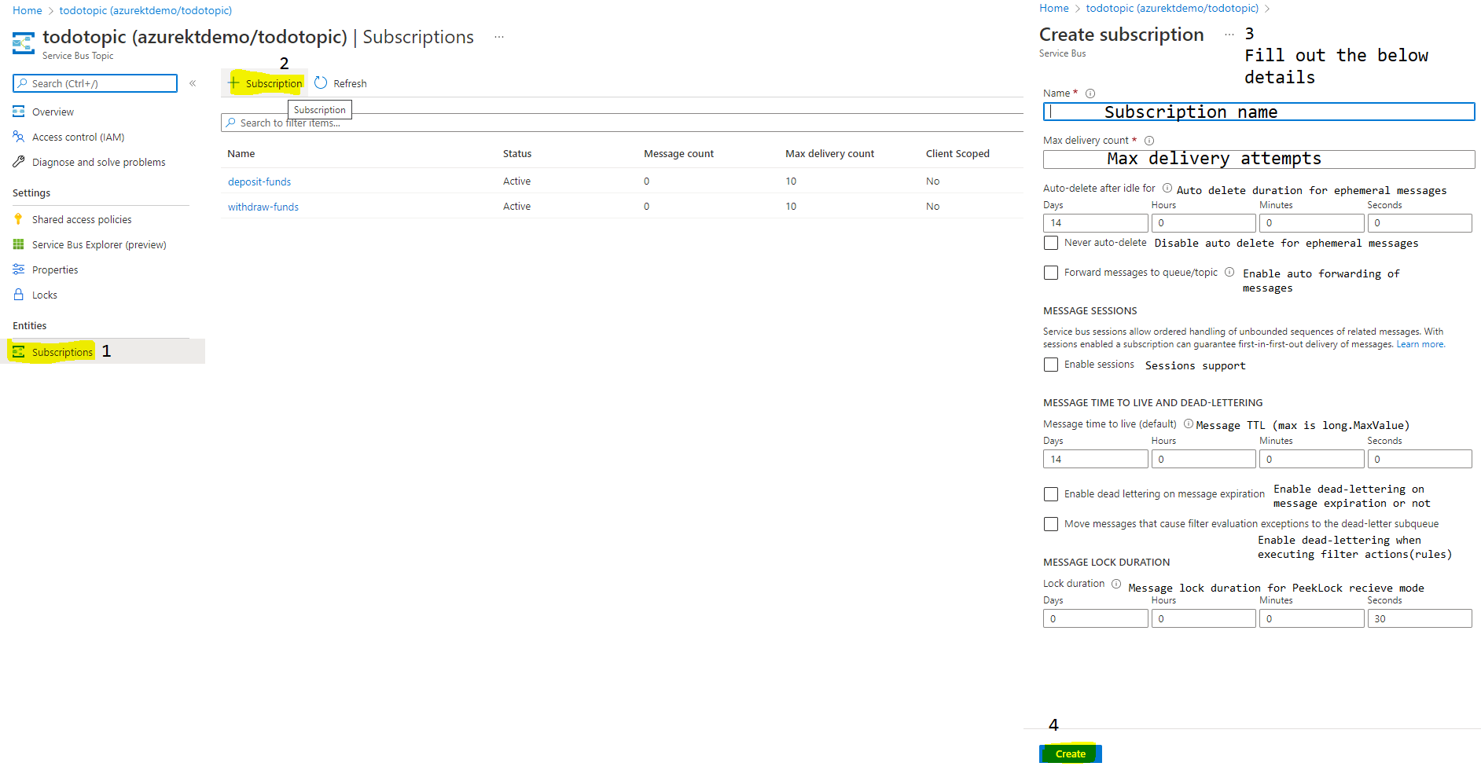
Create subscription wizard under Service Bus namespace

Slide 22
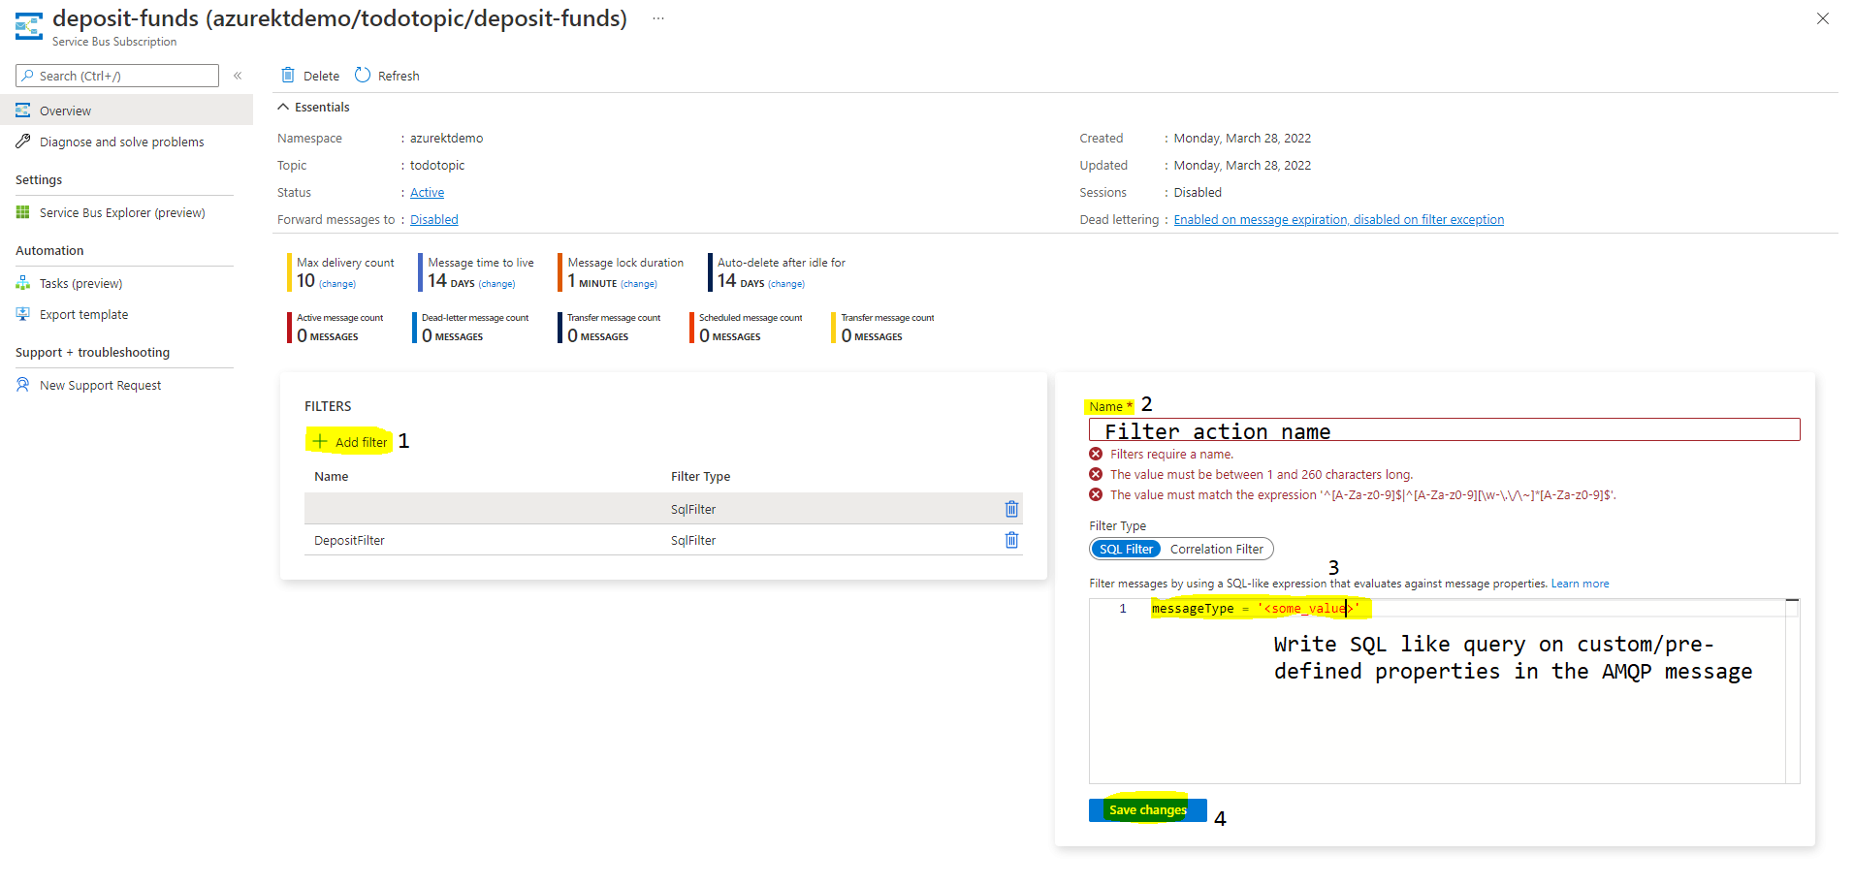
Create filter actions(rules) wizard under Service Bus namespace

Slide 23
SERVICE BUS TOPIC DEMO

Slide 24
Advanced Features
Azure Service Bus supports many advanced features
Geo replication (Pairing and failover processes)
Sessions
Partitioning
Deferred Messages
Manual dead lettering
De-Duplication of messages
Auto forwarding
Batching
Prefetch Count
Transactions

Slide 25
Geo Replication
Provides geo-redundancy for Azure Service Bus queues and topics/subscriptions.
We can pair one primary and one secondary service bus namespace.
After successful pairing, an alias is created, which we need to reference instead of directly referencing primary/secondary namespace.
Queues, topic/subscriptions with filter actions are asynchronously replicated constantly.
Only available on Premium tier namespace SKU.

Slide 26
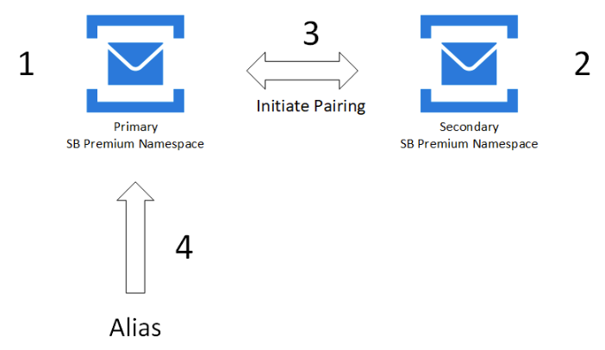
Geo replication pairing process
Step 1) Add Primary premium namespace in desired Azure region.
Step 2) Add Secondary premium namespace in desired Azure region.
Step 3) Initiate pairing.
Step 4) Copy root SAS key for Alias.
(Note: Root key has Send/Listen/Manage permissions, use with caution).

Slide 27
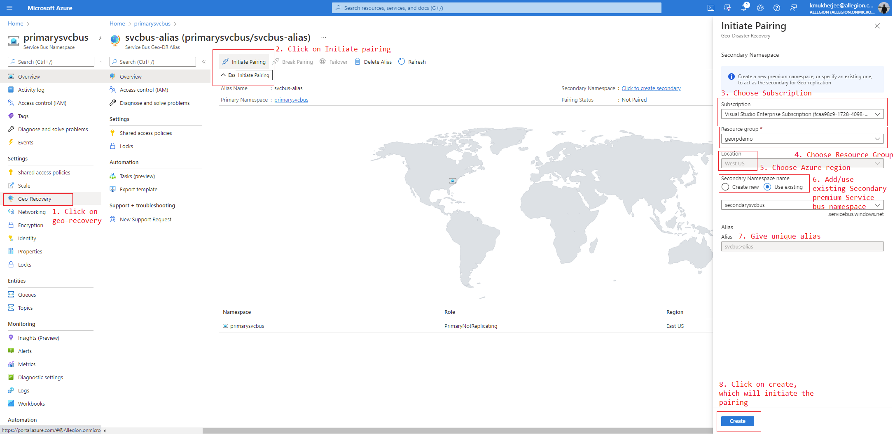
Step 3) Initiate pairing step (in detail)

Slide 28
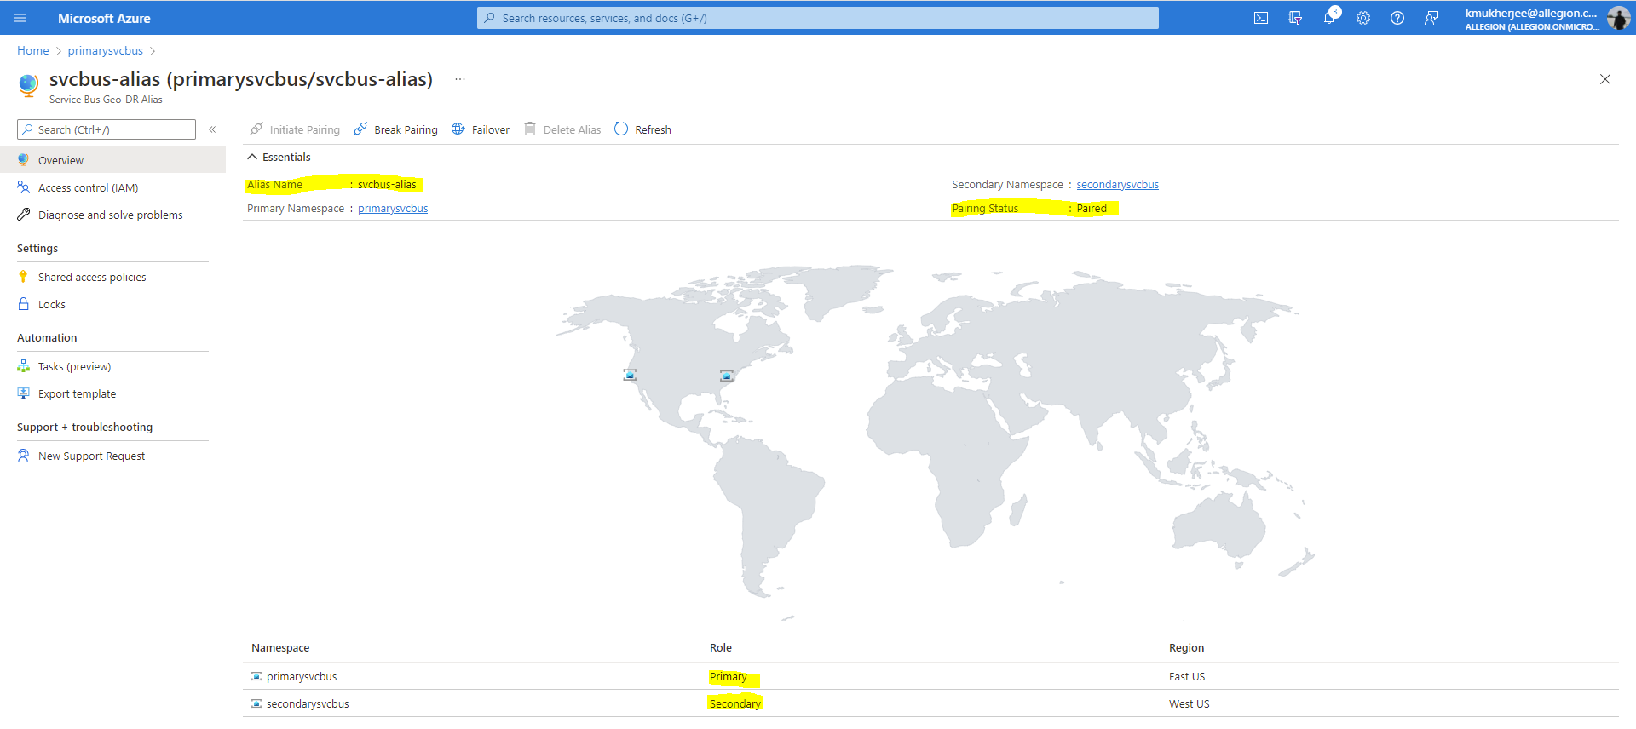
Once paired is complete it will show status as paired in the overview page.

Slide 29
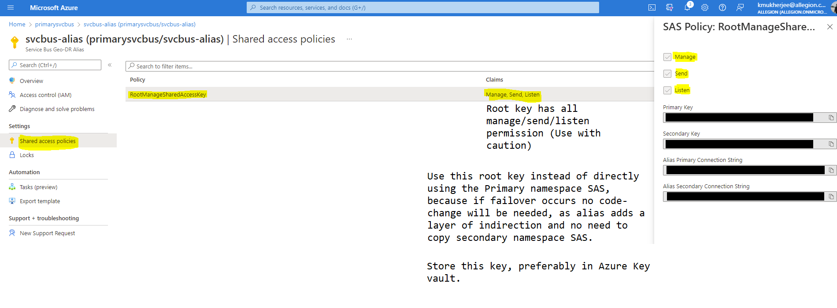
Step 4) Obtain root key for Alias

Slide 30
Types of failures in Azure Service Bus Geo-replicated namespace
Outage –
Intermittent failure of Azure Service Bus because of power loss/cooling failure/network outage or other temporary issues.
Disaster –
Act of god (Earthquake/Tsunami/Volcanic Eruption, etc.) in 1 or more Azure region or Availability Zone or within a data center, the effects of this damage could be either long-lasting or even permanent.

Slide 31
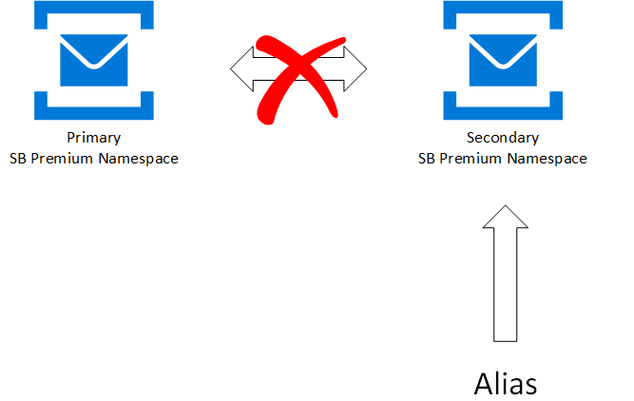
Failover process in an Azure Service Bus Geo-replicated setup
Step 1) Pairing breaks between primary and secondary namespaces due to outage or disaster.
Step 2) Automatic or manual failover kicks in.
Step 3) Secondary namespace becomes primary namespace.
Step 4) Alias now points to Secondary namespace.

Slide 32
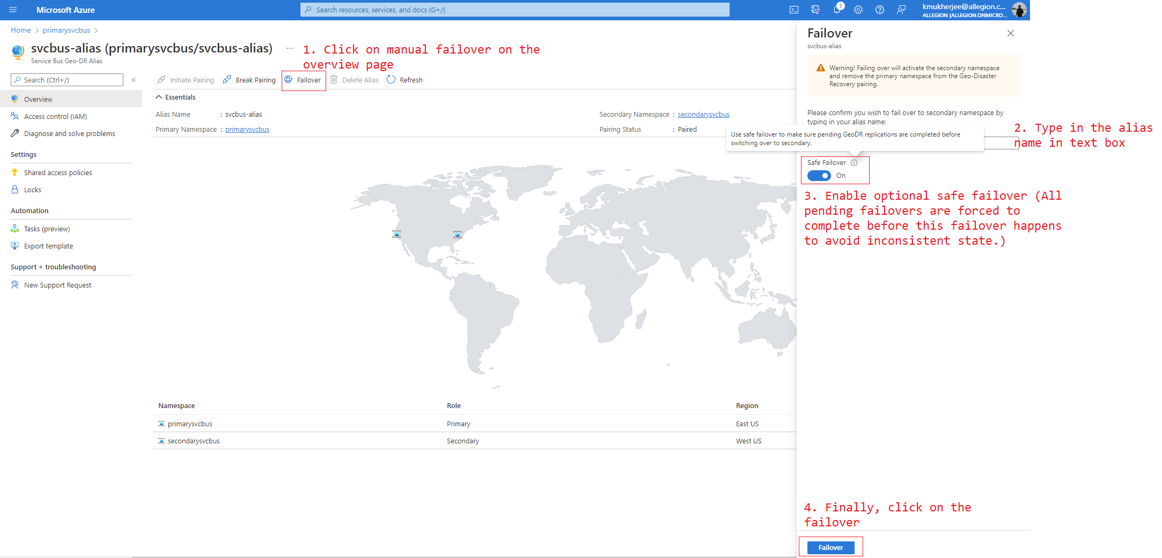
Manual failover in an Azure Service Bus Geo-replicated setup

Slide 33
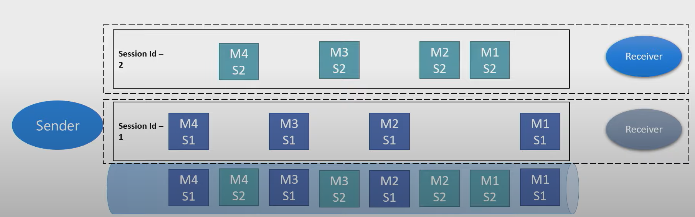
Sessions
Producer sets SessionId property in the message body.
Sessions acts as virtual sub-queues.
Guaranteed FIFO ordering of messages which have same SessionId.
Receiver locks down the entire session and processes them in order.

Slide 34
SESSIONS DEMO

Slide 35
Partitioning
When partitioning is enabled when creating the queue/topic, Service Bus assigns the published message to one of the partition.
Assignment can happen at random by Service Bus itself or by the producer application using PartitionKey property.
Partition key can be one of the following properties in the message –
MessageId
SessionId
PartitionKey
Partitions are nothing but multiple message brokers. Each message broker can have queue/topic inside them.
Receiving client is unaware of the partitioning logic happening inside and receives the message as usual.
Can increase the overall throughput in performance-centric scenarios and reduce single point of failure due to single message broker.
Also increases complexity as we need to monitor the partitions regularly to check if they healthy or not.

Slide 36
Deferred Messages
Messages processing can be deferred in the Producer and Consumer side.
Producer side deferring –
Producer can schedule a message to be delivered later.
Message is published as usual and accepted by Service Bus.
Message becomes visible only after the specified time.
Consumer side deferring –
Consumer can defer the message to be process at later point of time.
When deferred, Service Bus provides a sequence number to track the deferred message.
If that sequence number is lost, we cannot recover the message.

Slide 37
PRODUCER SIDE MESSAGE DEFERRAL DEMO

Slide 38
Manual Dead Lettering
Messages can be dead letter manually using ServiceBusReceiver.DeadLetterMessageAsync Method.
This method needs the following parameters –
ServiceBusReceivedMessage
A dictionary containing the reason to dead letter a message.
Optional cancellation token

Slide 39
De-duplication of messages
Prevents duplication of messages caused due to application failures or network outages.
Messages are de-duplicated based on the MessageId property.
Service Bus removes second and further submissions of messages having the same MessageId.
Choosing the MessageId carefully is very important for de-dup to work.
De-duplication only works in specified time window (Min of 20 seconds to max 7 days), this can be configured while creating the queue/topic.
If message is arriving within the above-mentioned time window its accepted, else its dropped.
Example scenario might be where the user is resubmitting a form and reloading the page doing which can potentially publish two identical messages in the Service Bus.

Slide 40
Auto forwarding messages
Auto forwarding allows us to forward messages automatically at broker-level to the chained queue/topic.
It is a guaranteed operation, which means it will never fail at the broker-level.
We can chain a queue/topic to another that is part of same namespace.
Once the message is forwarded to the chained queue/topic, it is dequeued from the original queue/topic it originated from.
Destination queue/topic must be created beforehand, or ServiceBus throws an exception.
We can’t have more than 3 chained queue/topics which are considered as hops, messages exceeding 4 hops will be transferred to the dead-lettered-queue.

Slide 41
Batching
Sending multiple messages one-by-one is very inefficient because of the round-trip latencies involved.
We can alternatively package multiple message into a single batch.
A single batch has an upper bound of 100 messages and should not exceed that.
The batch messages size should not exceed 256 KB (Basic/Standard) or 1 MB (Premium).
Batching operation is atomic, either it will succeed or fail. No inconsistencies involved.

Slide 42
BATCHING DEMO

Slide 43
Prefetch count
Prefetching allows the ServiceBusProcessor to store received messages into a local cache.
Prefetching messages from the local cache as opposed to pulling it one-by-one greatly increases the overall throughput.
Prefetching reduces the round-trips incurred to receive a single message from the queue/topic.
Prefetch count can be controlled by ServiceBusProcessor.PrefetchCount.

Slide 44
Transactions
We can group two or more Service bus operations in Transaction scope which behaves like RDBMS transaction giving capabilities to rollback and commit.
Operations grouped under a transaction are always atomic.
Type of operations permitted to grouped under transaction scope are –
Send
Complete
Abandon
Deadletter
Defer
Renew lock
Operations under a transaction scope cannot exceed 2 minutes.

